Slide 1



PRESENTED BY: TIAGO MARTINS
LAST UPDATED: 31 JAN 2024
THE WORLD OF DATA
JOB MARKET ANALYSIS

Slide 2


OBJECTIVE
This study is meant to provide the user insights about the data job market, with a special focus on salaries in this area.
HOW
through Exploratory Data Analysis (EDA) to obtain a visual understanding of the data;
using a Machine Learning model integrated in an app for more specific or custom insights;
LETS GET STARTED

Slide 3

ABOUT
THE DATA
around 5000 (useful) samples;
heavily focused in the US market;
most of the samples are from 2023;
some of the features:
gross salary
experience level
company location
employment type
work setting
company size
job title

Slide 4
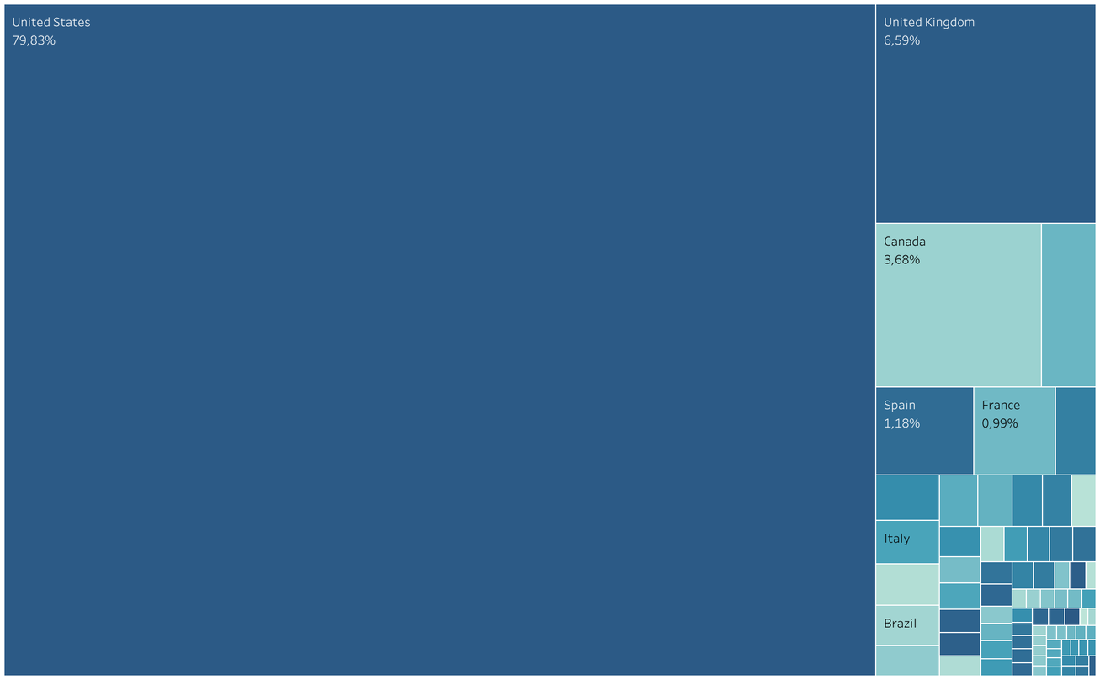

NUMBER OF SAMPLES BY COUNTRY
The dataset has a majority sample size of employees from the United States (around 80%).
United Kingdom is the second most represented country with around 7%.

Slide 5
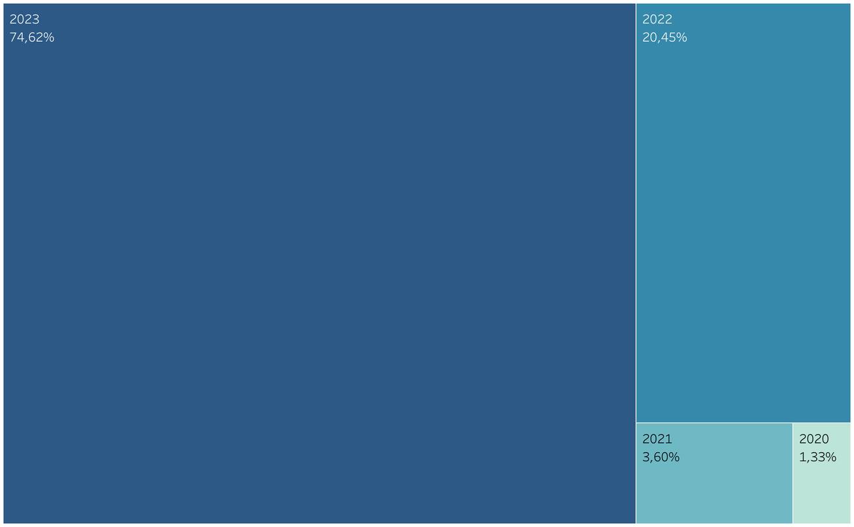
NUMBER OF SAMPLES BY YEAR
The year 2023 is by far the most represented year on this dataset.

Slide 6

EDA

Slide 7
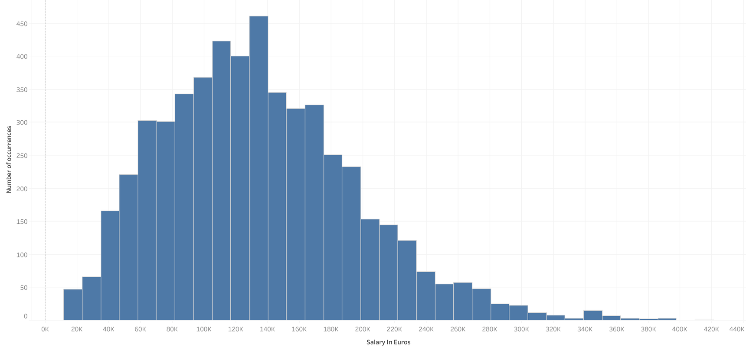
SALARIES OVERVIEW
In the plot below we can analyse the distribution of the yearly salaries across all fields of the data job market.
AVERAGE SALARY DISTRIBUTION
MINIMUM
≈ 20K
MOST FREQUENT
≈ 130K
MAXIMUM
≈ 400K

Slide 8
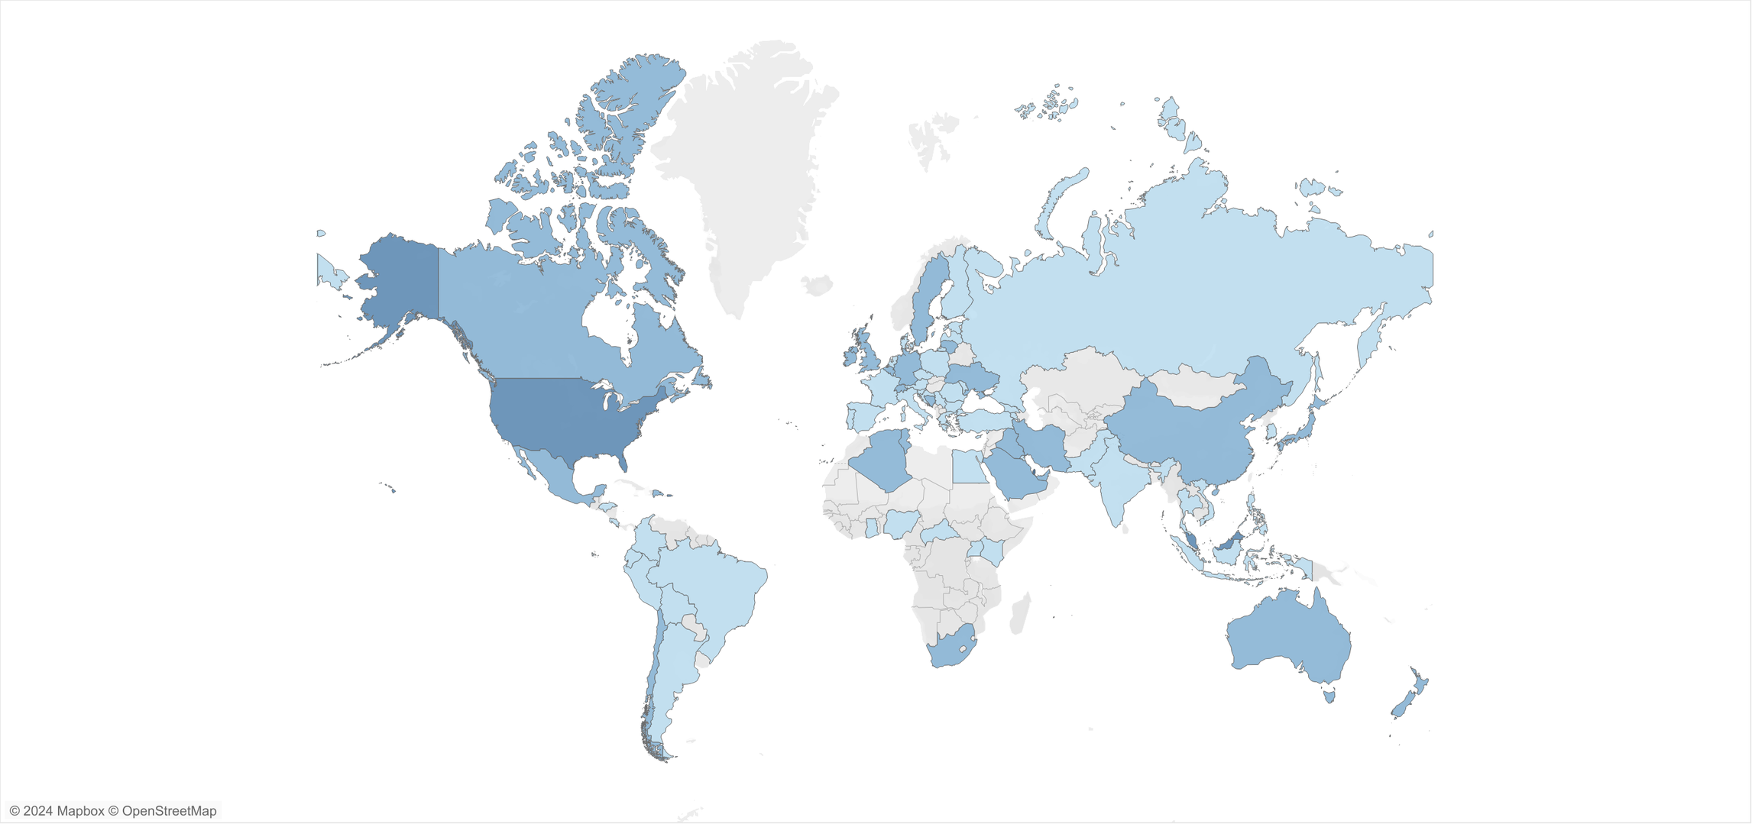
SALARIES AROUND THE WORLD
AVERAGE SALARIES BY COUNTRY
INSIGHTS:
High variability of average salaries around the world;
No apparent correlation between salaries and geographical location;
Lack of data to extract insights from many countries in Africa and Asia;

Slide 9
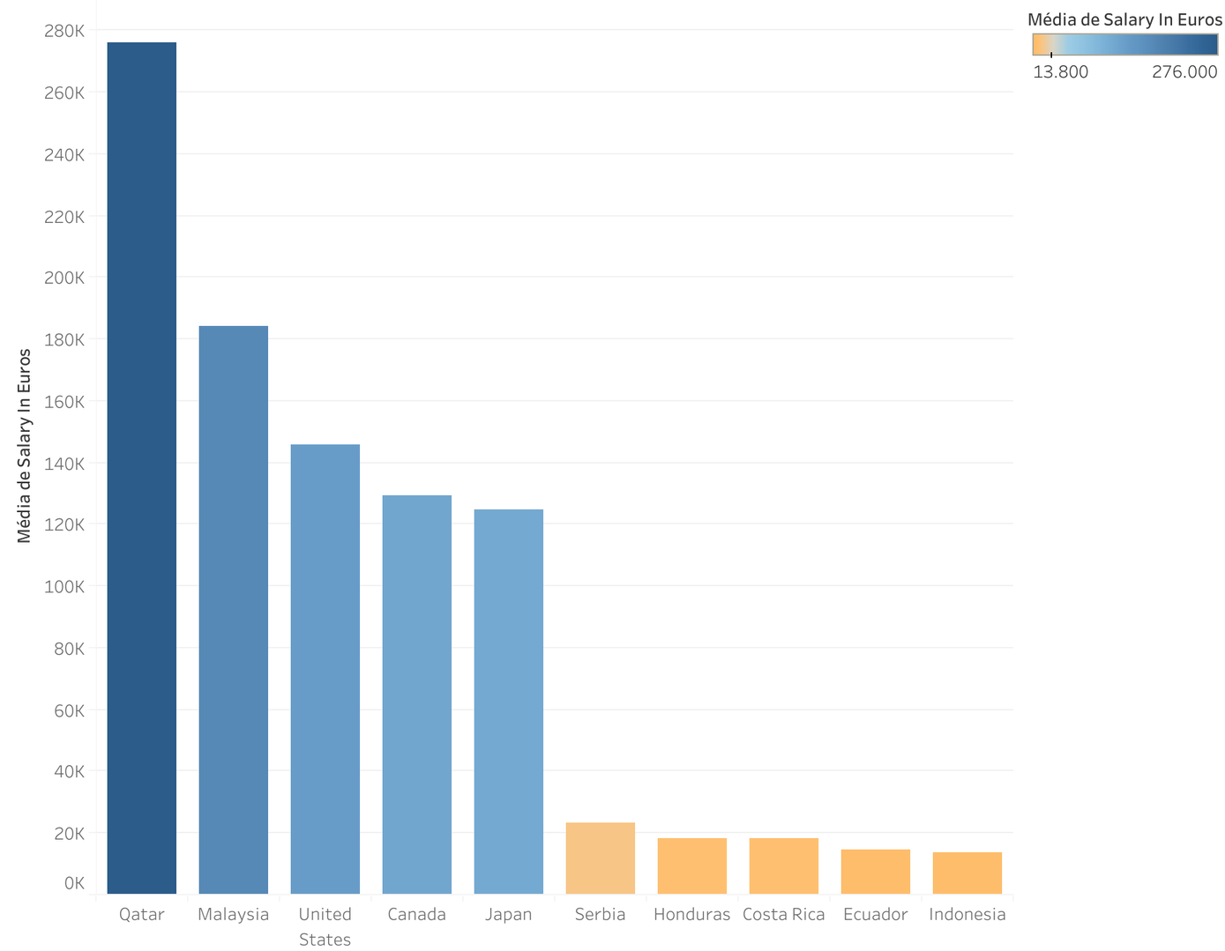

TOP AND BOTTOM 5 COUNTRIES BY SALARY
TOP AND BOTTOM 5 COUNTRIES BY AVERAGE SALARY
TOP COUNTRIES:
On the right, represented in blue bars, are the top 5 countries with highest average salaries, the highest being Qatar with around 280k euros yearly.
BOTTOM COUNTRIES:
Represented in orange bars, are the bottom 5 countries with the highest average salaries, the lowest being Indonesia with less than 20k euros yearly.

Slide 10
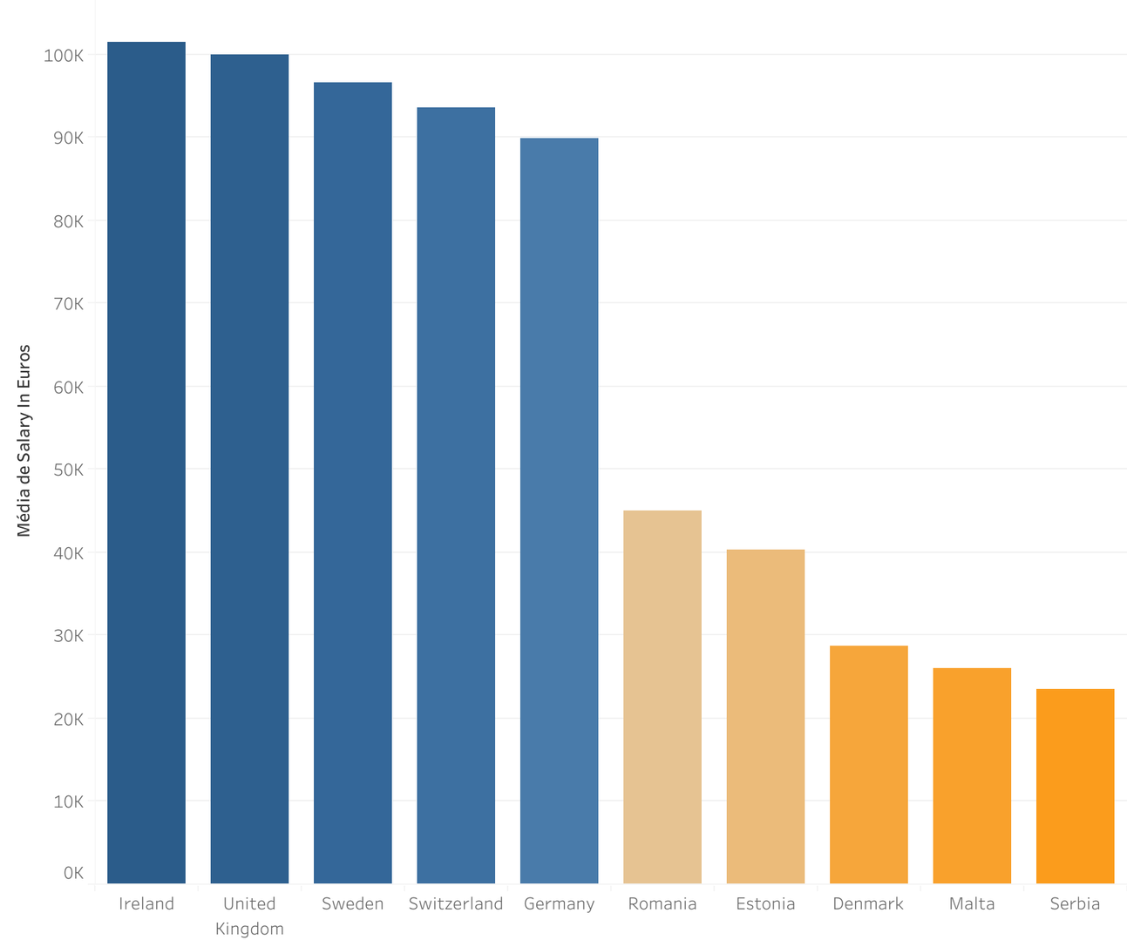
TOP AND BOTTOM 5 EUROPEAN COUNTRIES BY SALARY
TOP AND BOTTOM 5 EUROPEAN COUNTRIES BY AVERAGE SALARY
TOP COUNTRIES:
On the right, represented in blue bars, are the top 5 countries with highest average salaries, the highest being Ireland with around 100k euros yearly.
BOTTOM COUNTRIES:
Represented in orange bars, are the bottom 5 countries with the highest average salaries, the lowest being Serbia with around 20k euros yearly.

Slide 11
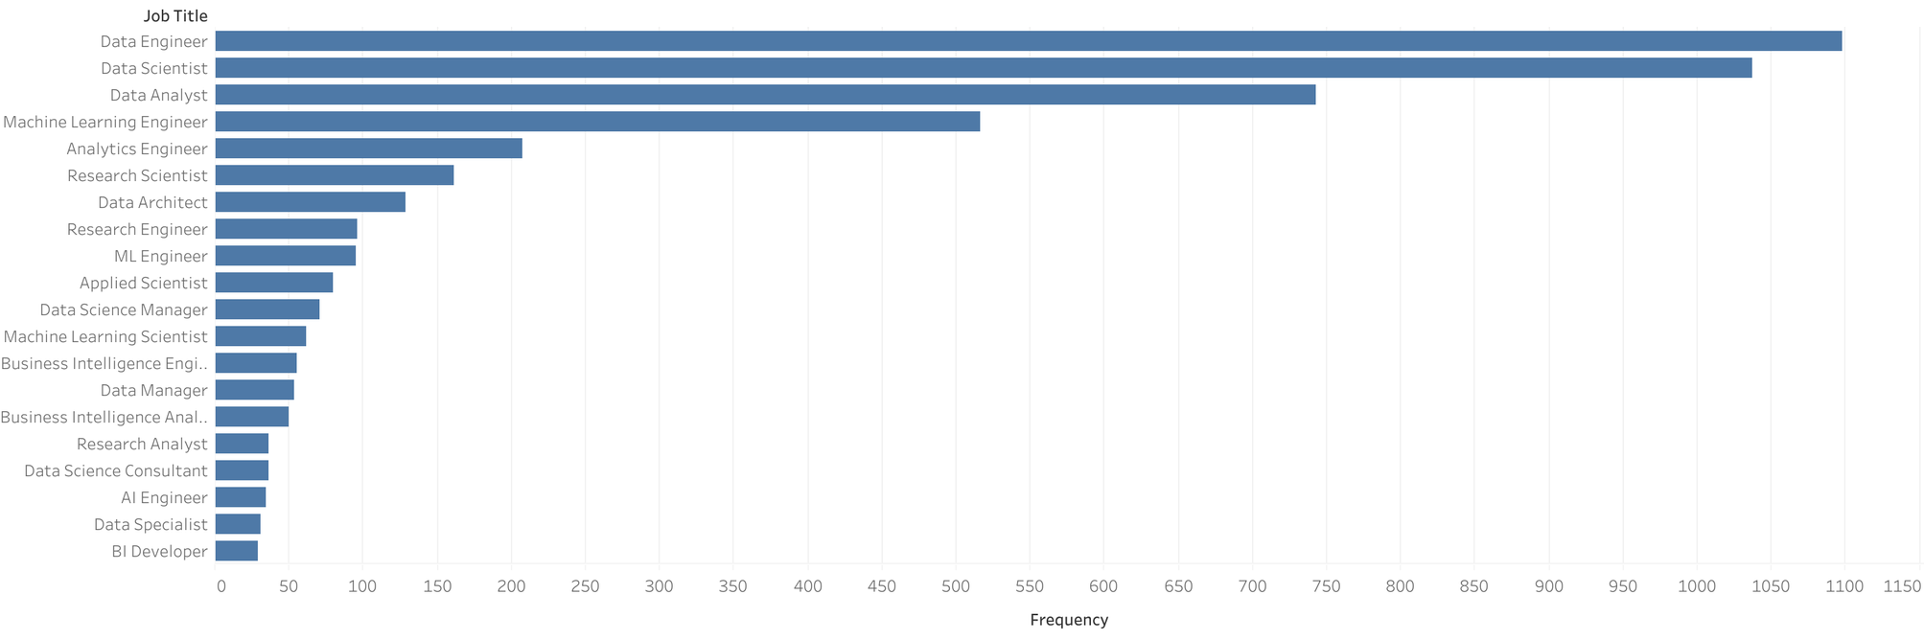
HIGH NUMBER OF JOB TITLE DESCRIPTIONS
There is a high cardinality in terms of job titles in the data world. In fact, from the data collected there were around 120 unique job title descriptions. Below we can see the top 20 most common ones.
TOP 20 MOST FREQUENT JOB TITLES

Slide 12
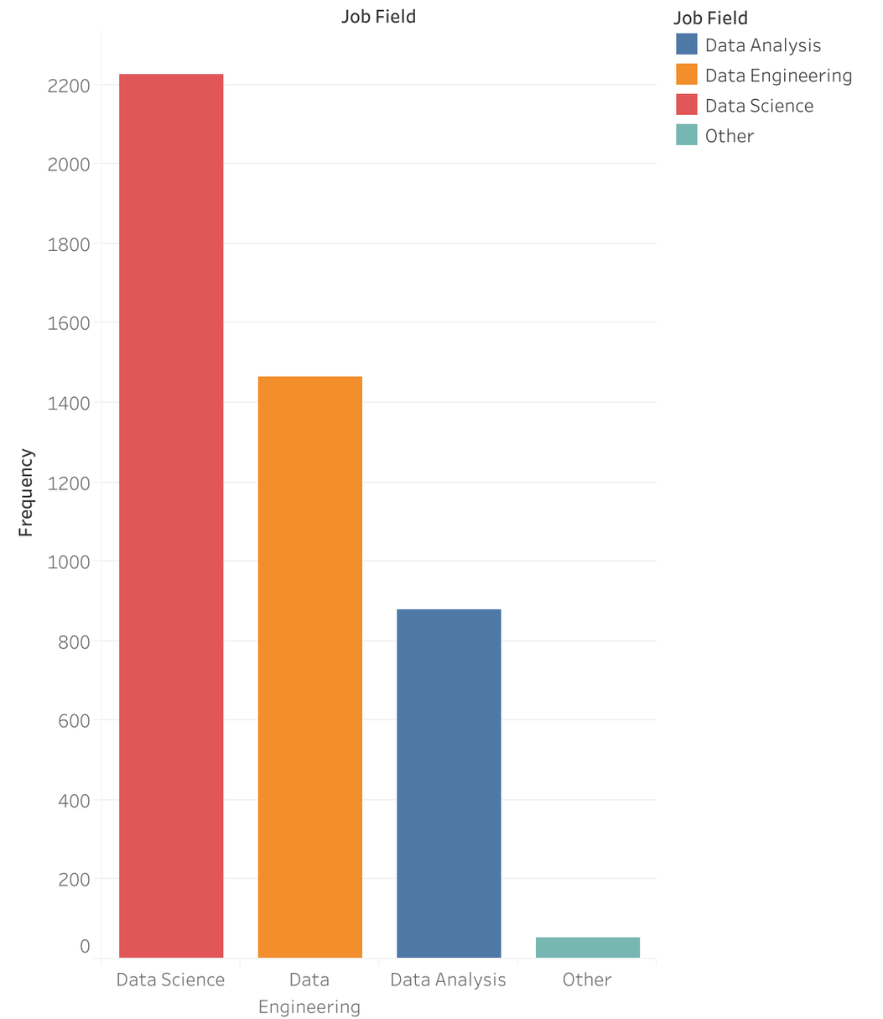
NUMBER OF JOBS PER FIELD
JOB FIELDS
For a clearer understanding of the data, the job titles were converted into 4 job fields as you can see on the graphic on the right.
This will help us better understand the data when we use them to analyse different variables.

Slide 13
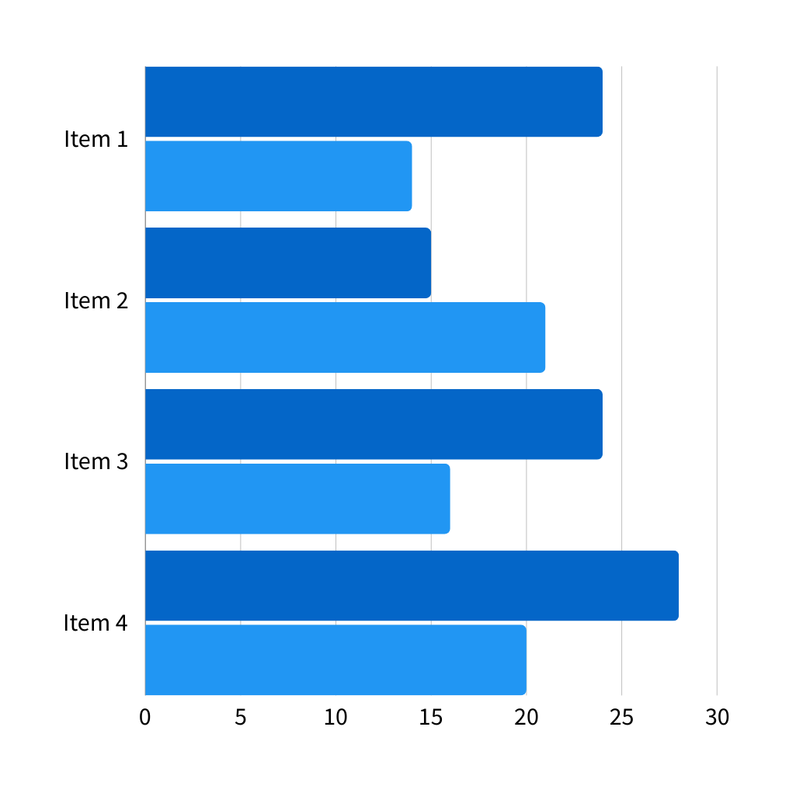
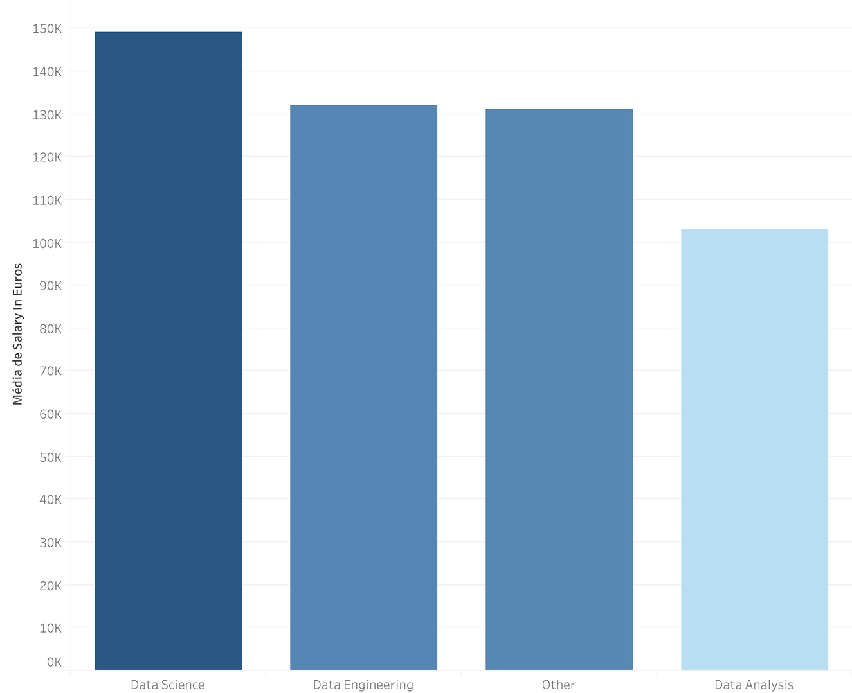
AVERAGE SALARY BY JOB FIELD
SALARIES BY JOB FIELD
INSIGHTS:
By analysing the average salary per job field we can see that:
Data Science has the highest average salary of around 150k yearly;
Data Analysis has the lowest average salary of around 100k yearly;

Slide 14
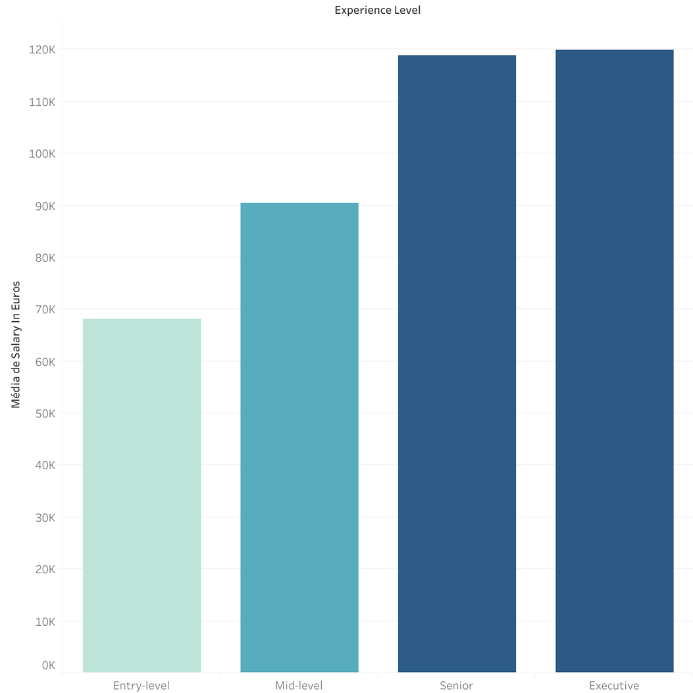
DATA ANALYST SALARIES BY EXPERIENCE LEVEL
DATA ANALYSIS -
EXPERIENCE LEVEL
INSIGHTS:
The average salaries in the field of data analytics can fluctuate between around 70k for an entry-level data analyst and around 120k for an executive level one.

Slide 15
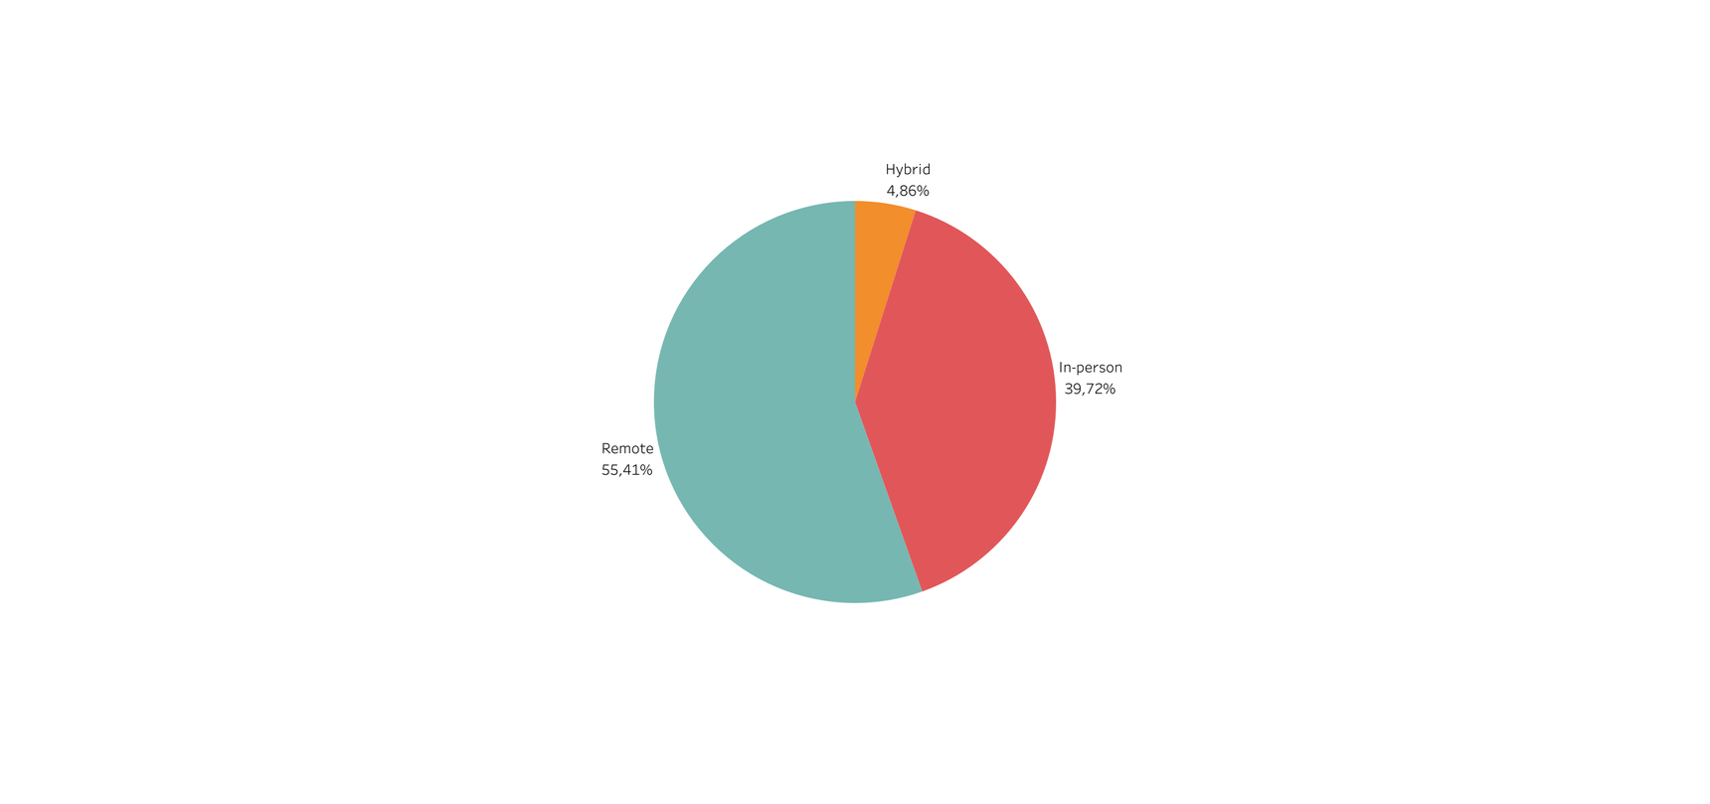
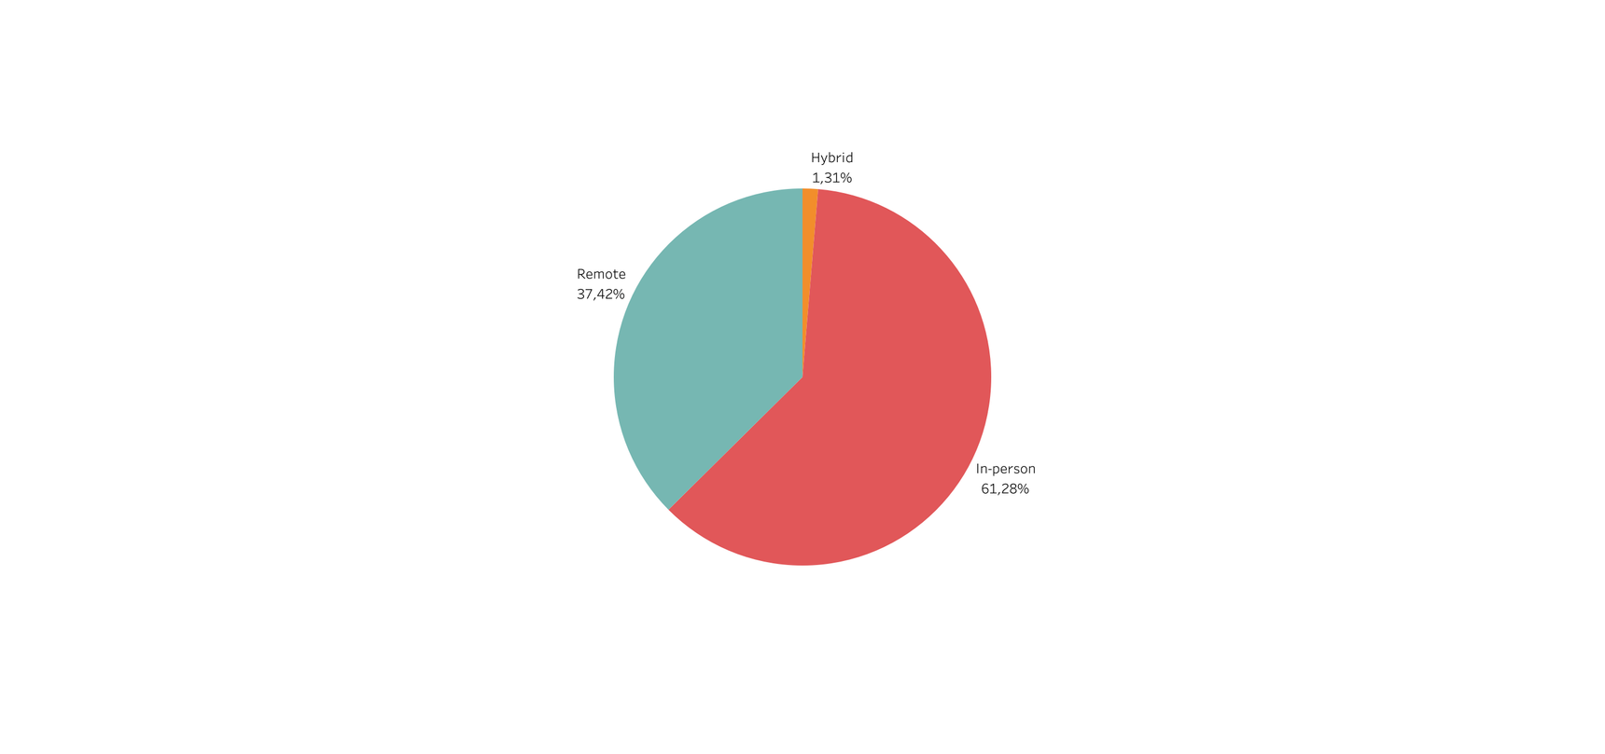
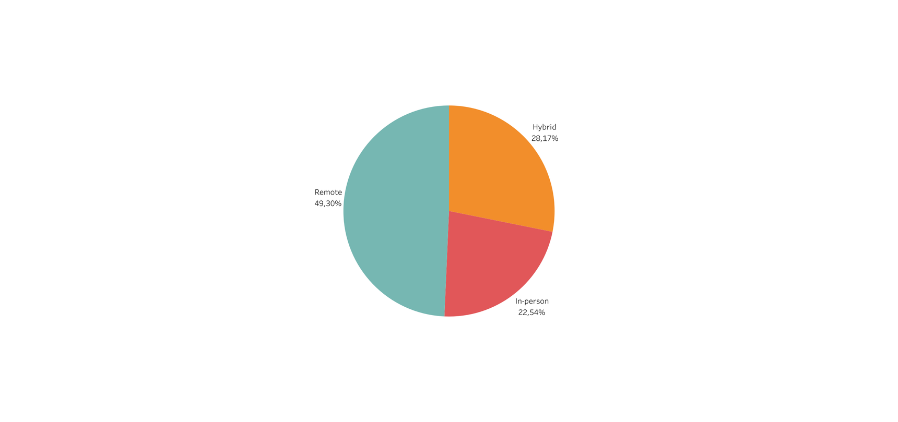
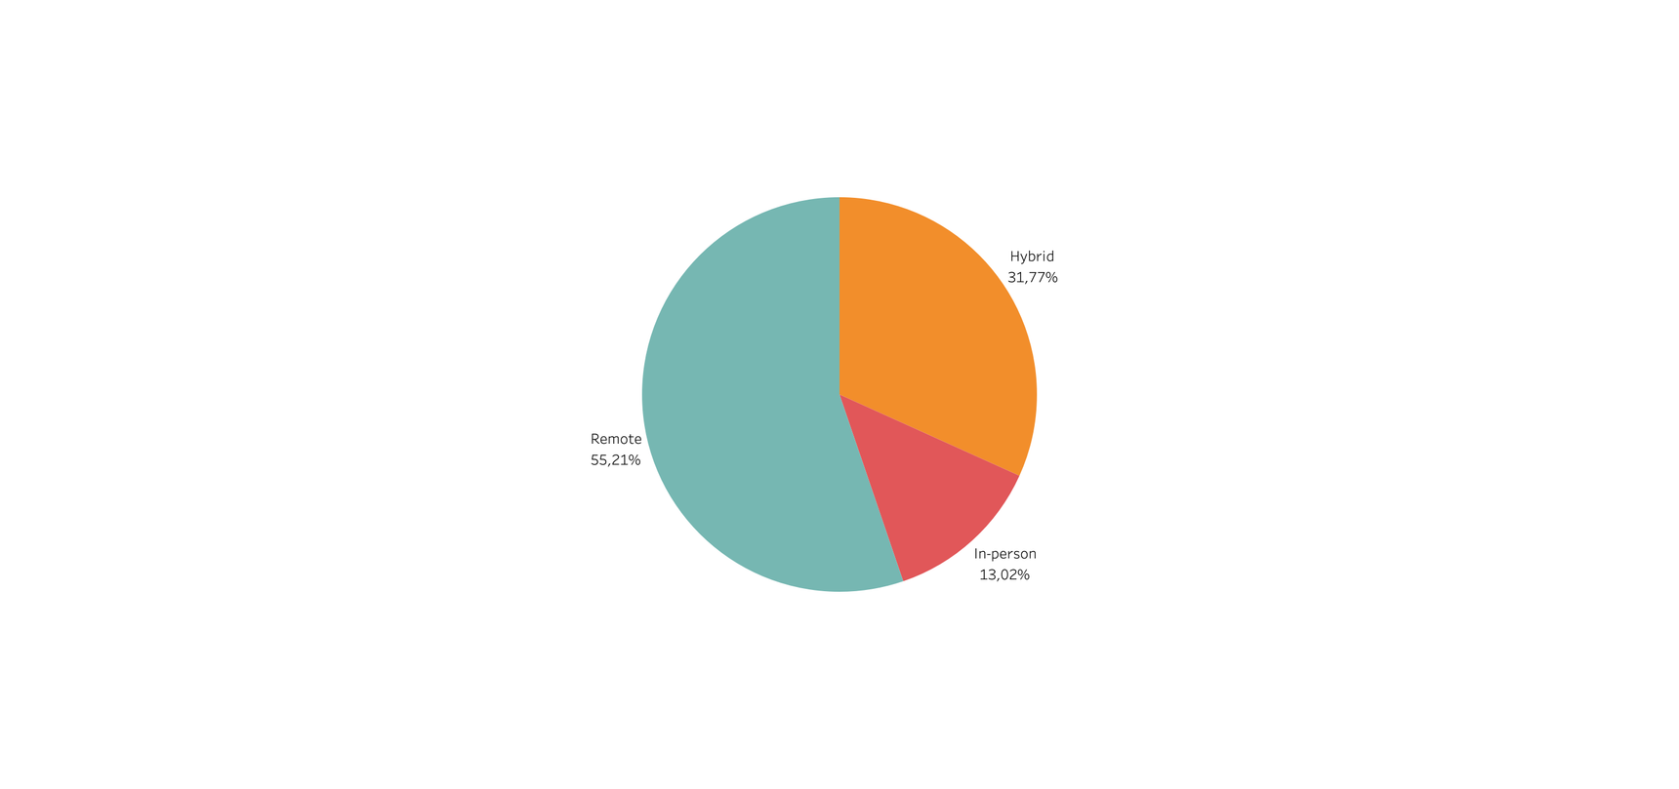
WORK SETTING BY YEAR
In the available timeframe (2020-2023) of the dataset we can see some big changes from year to year:
A very high percentage of hybrid and remote work settings in 2020 and 2021;
From 2022 the In-person (office) work setting becomes more prevalent becoming the majority in 2023;
One possible explanation could be COVID restrictions being gradually lifted after 2021;
2020
2021
2022
2023

Slide 16
NOW, FOR MORE CUSTOM INSIGHTS...

Slide 17

2. THE APP

Slide 18

WHAT DOES IT DO?
The app is a salary predictor, that calculates, using a machine learning model, the expected salary based on the user input regarding different variables like:
Job field
Location
Experience Level
Work setting
Type of employment
Company size
LETS TAKE A LOOK?

Slide 19

OPTIMIZING THE APP
IMPROVING DATA COLLECTION
Collecting more sample data and new sources.
ALGORITHM IMPROVEMENT
Better parameter optimisation for increased model performance and also researching and testing different types of models.
UI
Improving the UI for a more user friendly environment.

Slide 20
THANK YOU!

